Slide 1



Club Membership System Database
Name: Sai Karthik Gutha
Databases and data warehouses
Professor James Ashford

Slide 2
Contents
Requirements of the Database
ER Diagram
Relational Schema
Star Schema
Data Warehouse Requirements

Slide 3
Requirements of the Database
Member Details
Payment Information
Event Information
Membership Status

Slide 4
Requirements of the Database
Operations
Information Tracked
The club membership system will capture operations such as registration, membership plans, payments, and event management. It will also track member information, payment details, event organization, and membership status.
The information to be tracked includes member details, payment information, event information, and membership status information. Each of these elements is crucial for effective management and organization of club membership activities

Slide 5
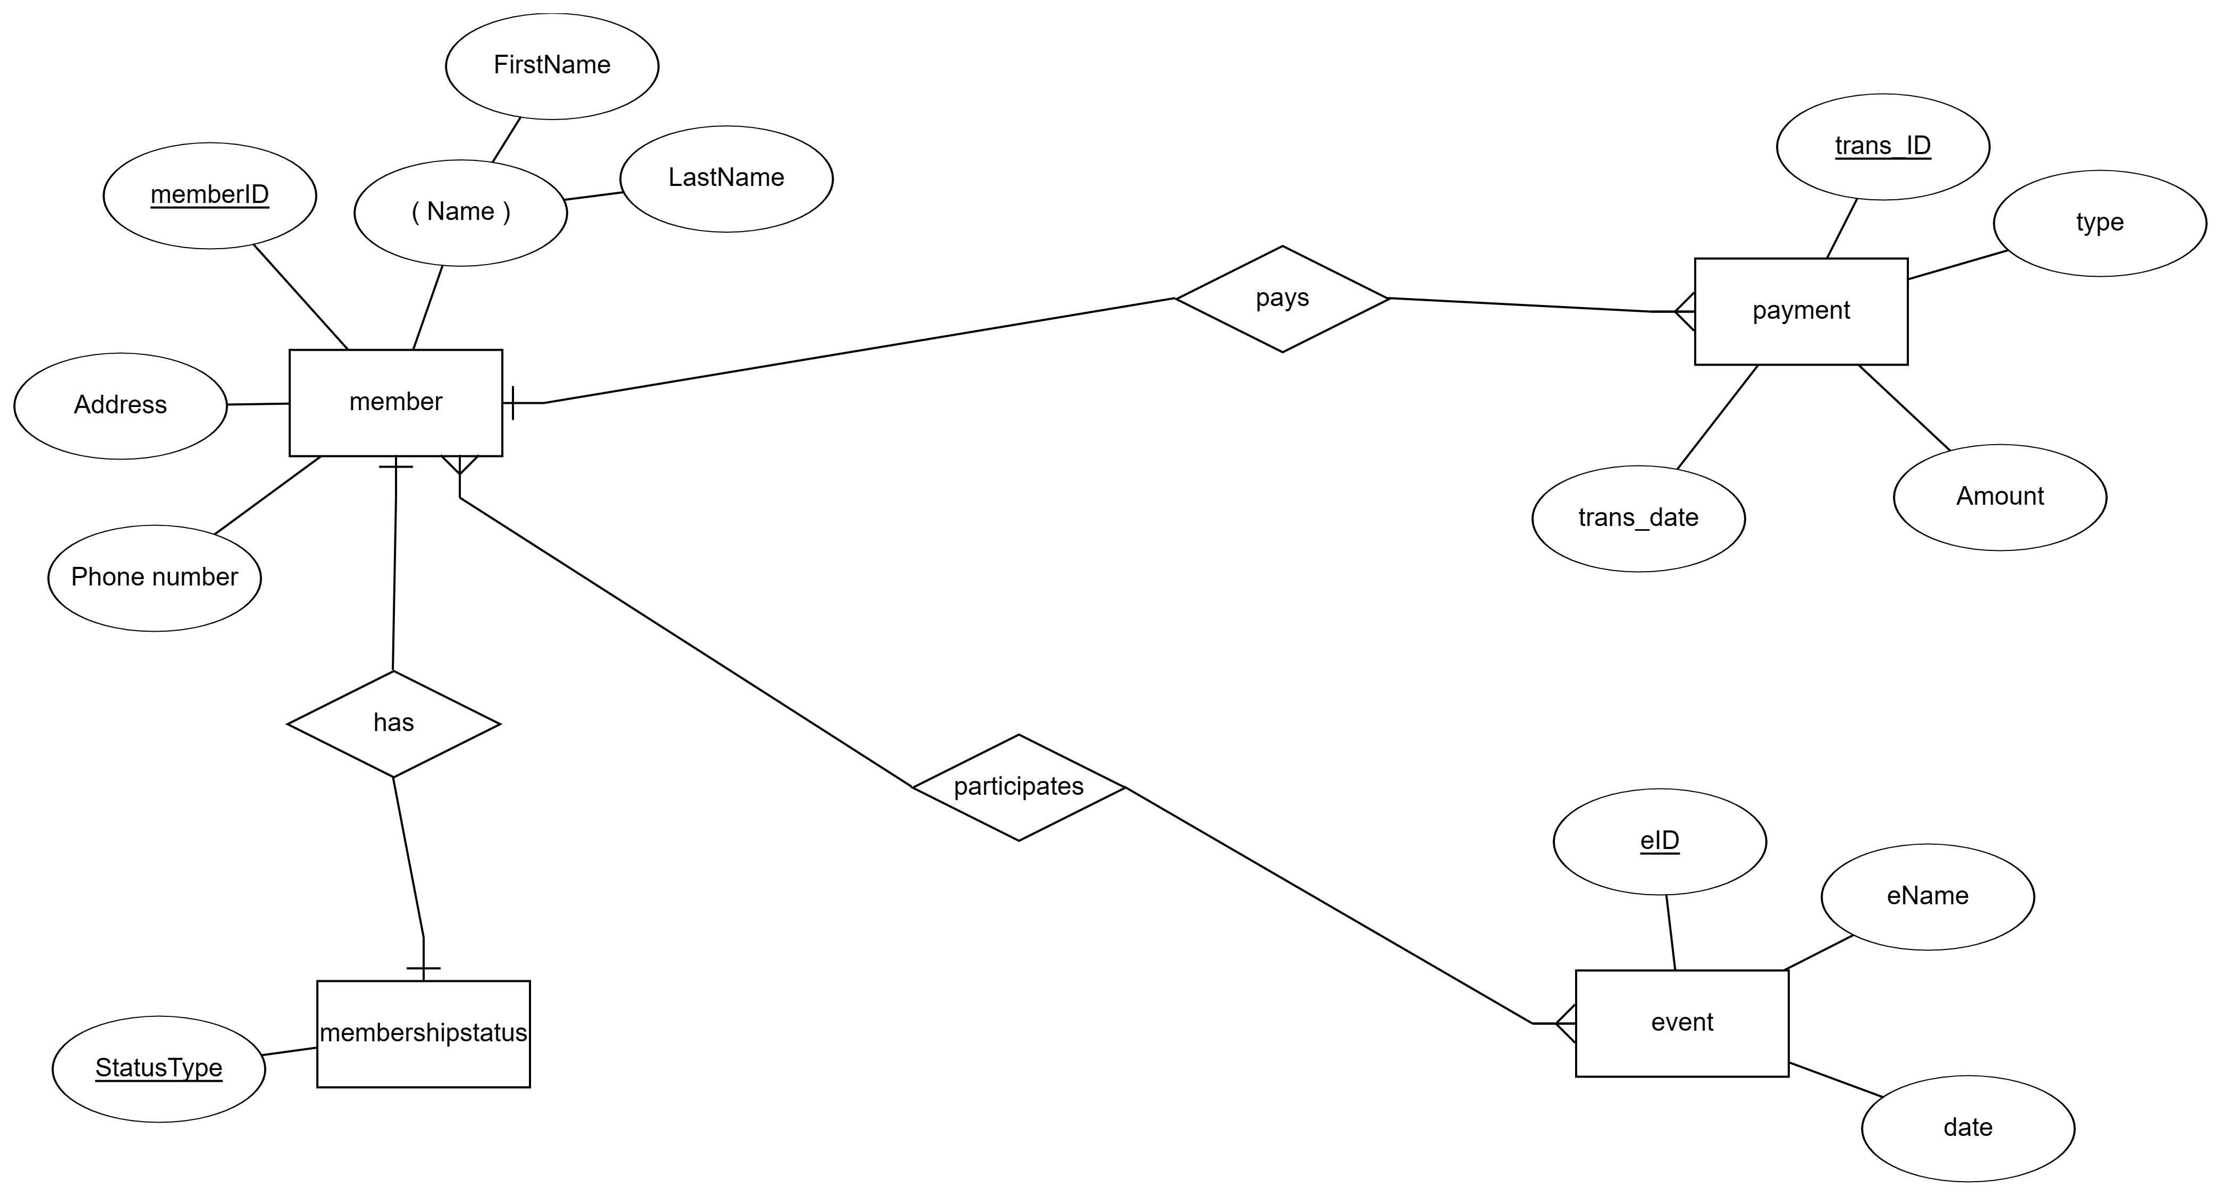
ER DIAGRAM

Slide 6

Entities, relationships and constraints
Entities:
Member: This entity represents a member of a club or organization. It has attributes such as memberID, Name, Address, and Phone number.
Membership Status: This entity represents the different membership statuses that a member can have, such as "Active", "Inactive", or “Suspended".
Event: This entity represents an event that the club or organization. It has attributes such as eID, eName, date, and type.
Payment: This entity represents a payment made by a member. It has attributes such as transID, trans date, and Amount.

Slide 7
Relationships:
Member to Membership Status relates to one-to-one relationship (1:1).
Member to Event is relates too Many-to-Many to relationship (M:N).
Member to Payment is relates too One-to Many relationship (1:N).
Constraints:
The memberID attribute of the Member entity is likely the primary key, as it uniquely identifies each member.
The eID attribute of the Event entity is likely the primary key, as it uniquely identifies each event.
The transID attribute of the Payment entity is likely the primary key, as it uniquely identifies each payment.
The combination of the memberID and eID attributes may form a composite primary key for the participates relationship, as it uniquely identifies each member's participation in each event.

Slide 8
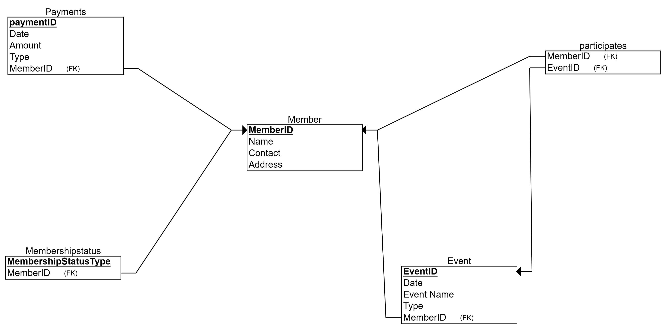
RELATIONAL SCHEMA

Slide 9

Relational Schema
The relational schema consists of four tables or relations: Member, Membership Status, Events, and Payments. Each table holds specific attributes related to member, membership status, events, and payments.
The Member table contains information about each club member, including memberID, name, contact, and address. The Membership Status table tracks the status of each membership, while the Events table holds information about events organized by club members. The Payments table records details of each payment made by members to maintain their club membership.

Slide 10
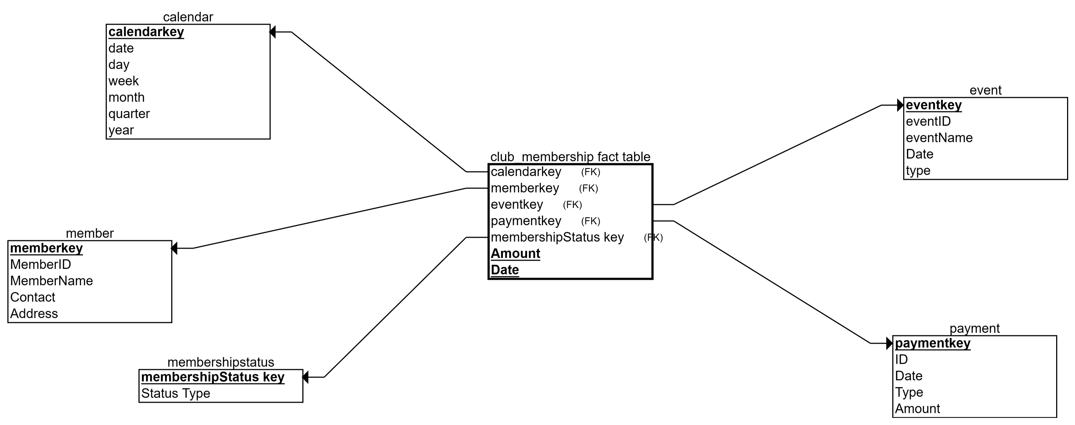
STAR SCHEMA

Slide 11

STAR SCHEMA
Fact Table: The fact table in the star schema connects all dimensions using foreign keys. It includes attributes such as member key, event key, payment key, membership Status type key, date, and amount. These attributes facilitate comprehensive analysis and reporting within the data warehouse.
Dimension: The star schema includes dimensions such as Calendar, Member, Event, and Payment. Each dimension represents specific aspects of the club membership system, including daily updates, member details, event management, and payment records.

Slide 12

DATA WAREHOUSE REQUIREMENTS
Member: Analyzing data at the individual member would involve measures such as total payments made, events attended, and current membership status for each member.
Membership Status: Analyzes the data, member can check only membership status is active or inactive or suspended.
Event: Analysis at the event level could include measures like the total attendance, total revenue generated, and the types of events that attract more members.
Payment: Analyzing payments might involve measures such as total revenue, average payment amount, and the distribution of payment types.

Slide 13

THANK YOU

